Slide 1

Deploying Python Applications
N.Yashwanth Naidu

Slide 2
Introduction
Objective:
Overview of various methods to deploy Python applications on AWS
Agenda:
Deploying with EC2 manually
Deploying with User Data
Using Bash Scripting
Git, Jenkins and Terraform Integration
Docker and Kubernetes Deployments

Slide 3
Method 1 - Manual Deployment on EC2
Overview:
Deploy Multiple Python applications manually using AWS EC2.
Steps:
Launch EC2 instance with required ports.
Install Python, pip, and git.
Clone Flask application and install dependencies.
Edit app.py to listen on all interfaces.
Run the application and access via public IP and port.

Slide 4
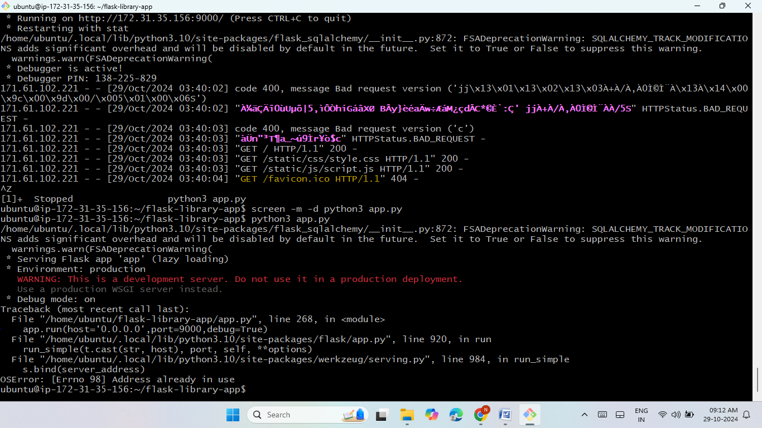
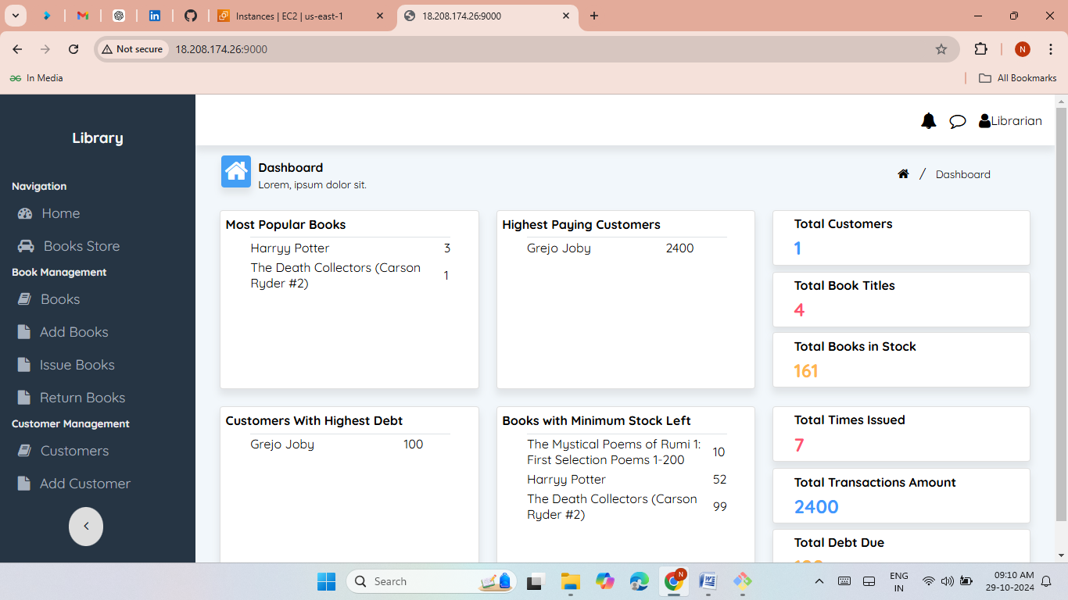
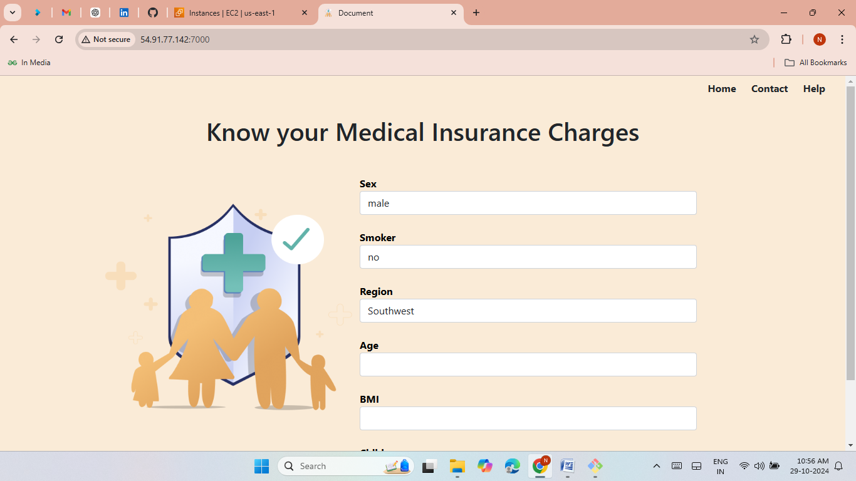
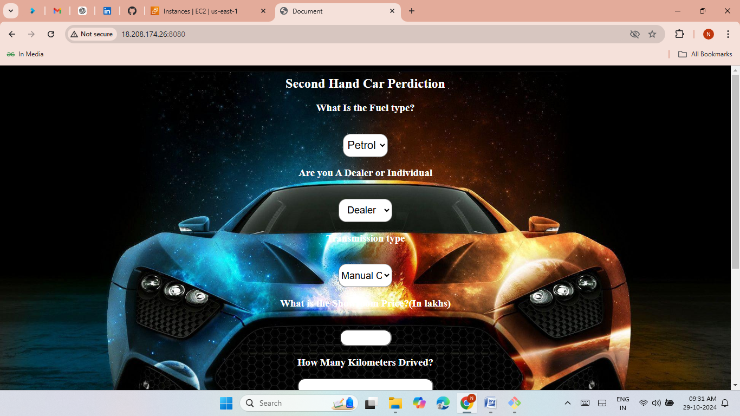
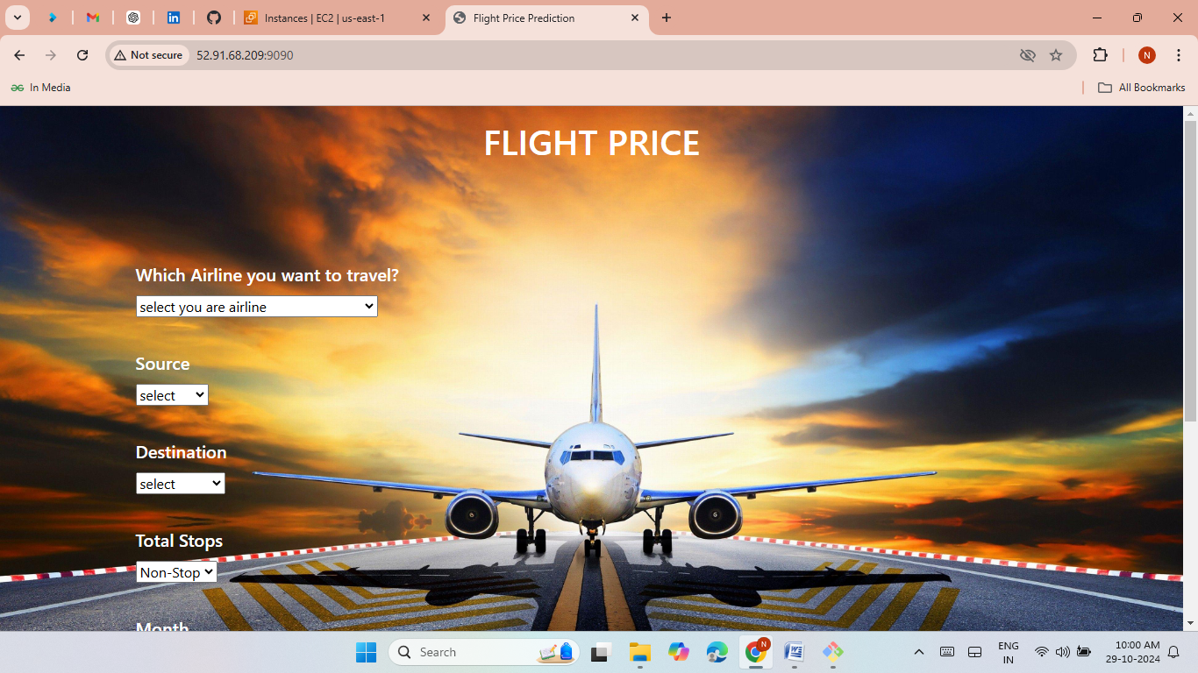
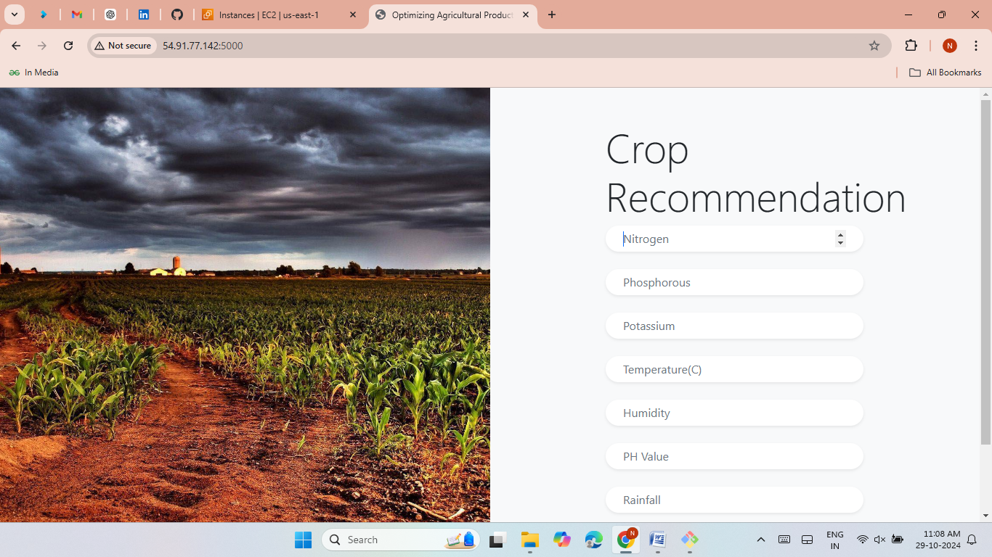
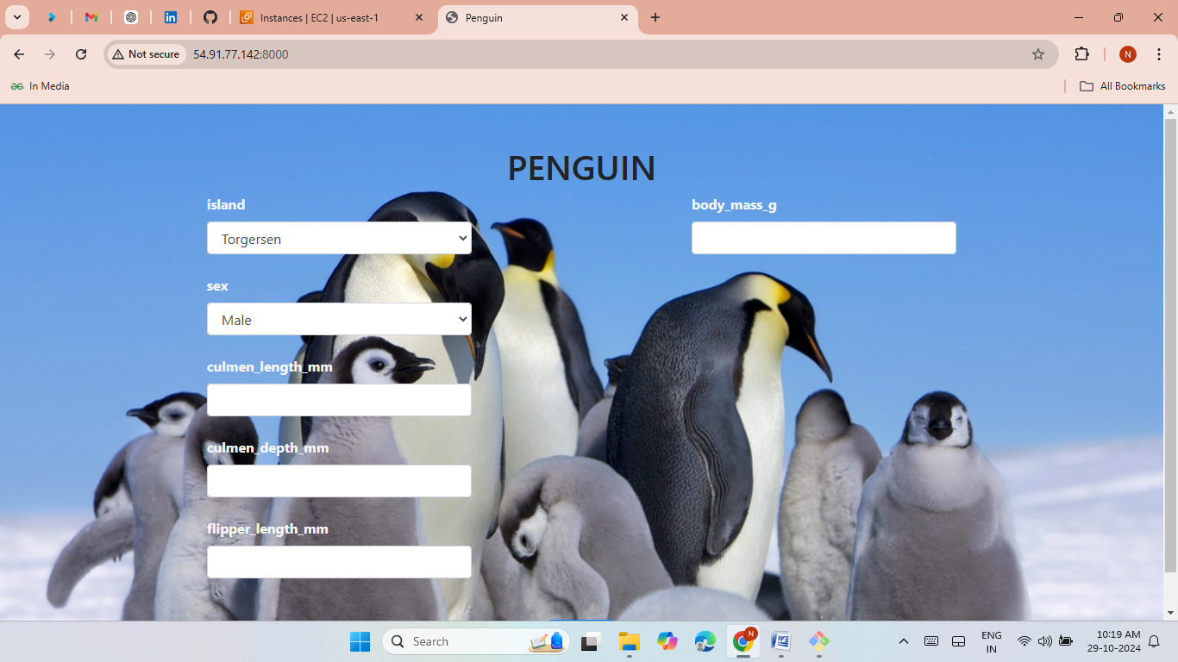
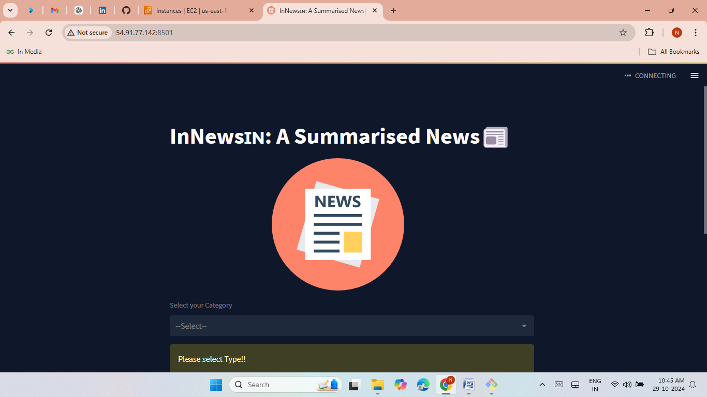
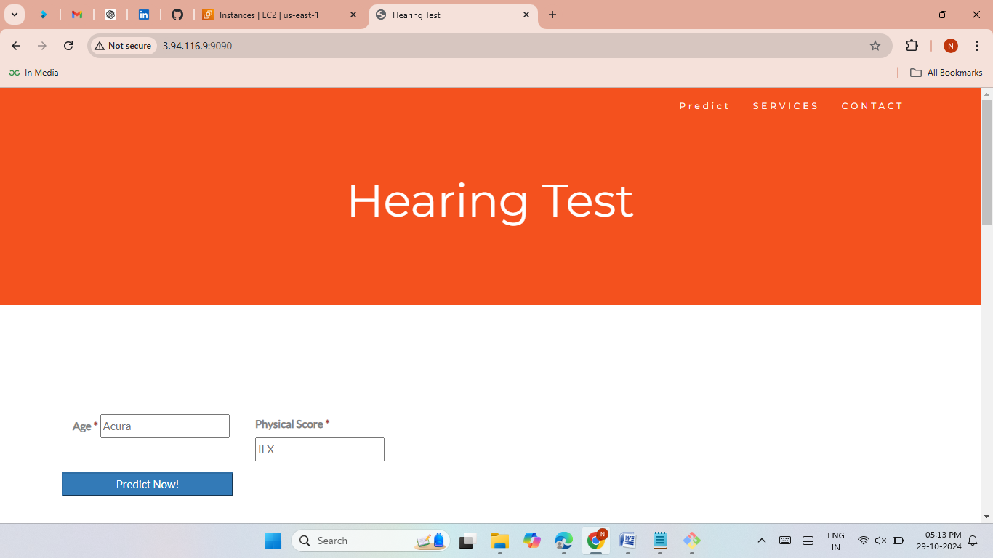

Slide 5
Method 2 - EC2 Deployment with User Data
Overview:
Automate deployment using EC2 User Data.
Steps:
Configure User Data with required installation commands.
Clone the repository and install packages.
Run the application automatically on instance launch.
Benefit:
Automates deployment on instance start.

Slide 6
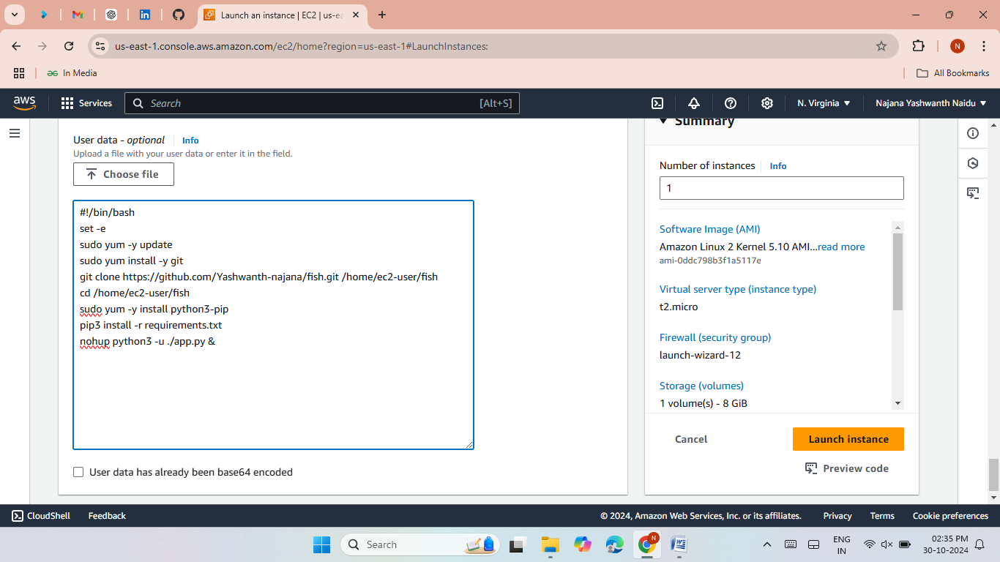
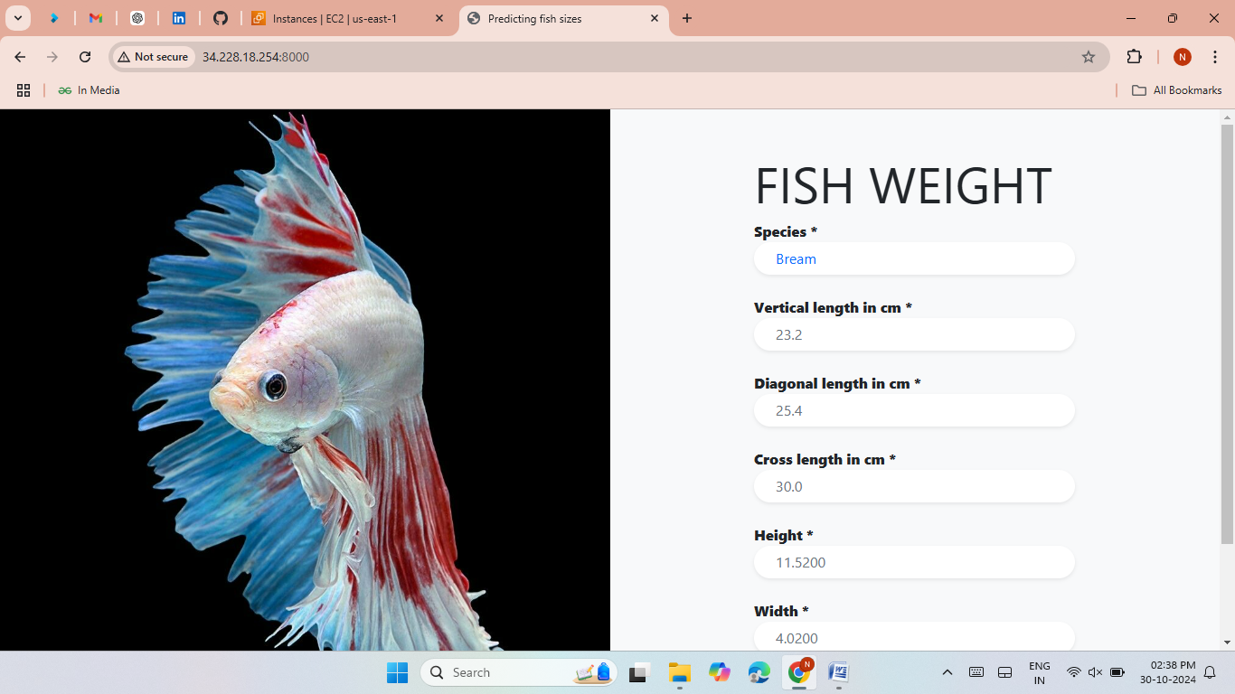

Slide 7
Method 3 - Bash Scripting
Overview:
Use a Bash script to deploy the application.
Steps:
Write a Bash script to automate installation and configuration.
Run the script on the EC2 instance.
Benefit:
Reusable script for multiple deployments.

Slide 8
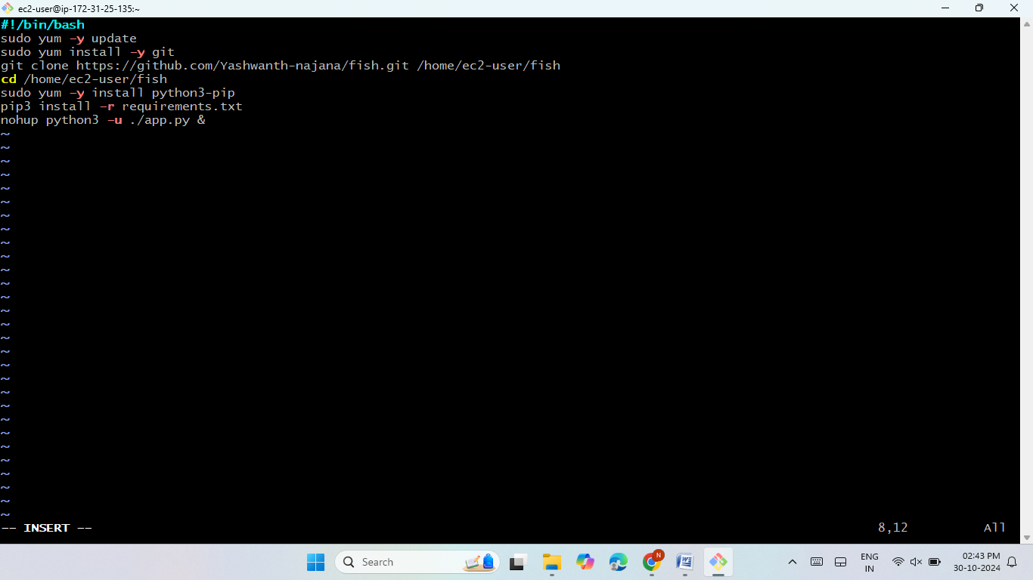
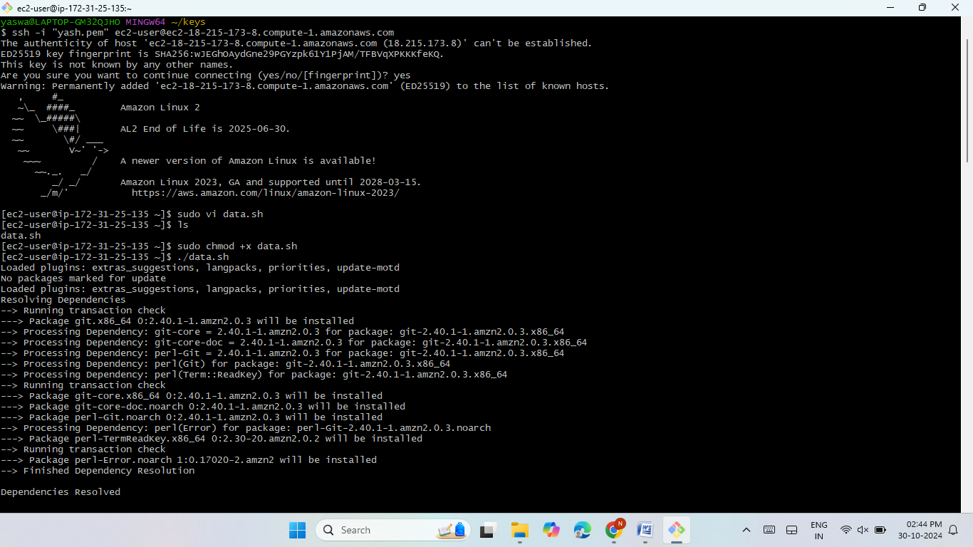
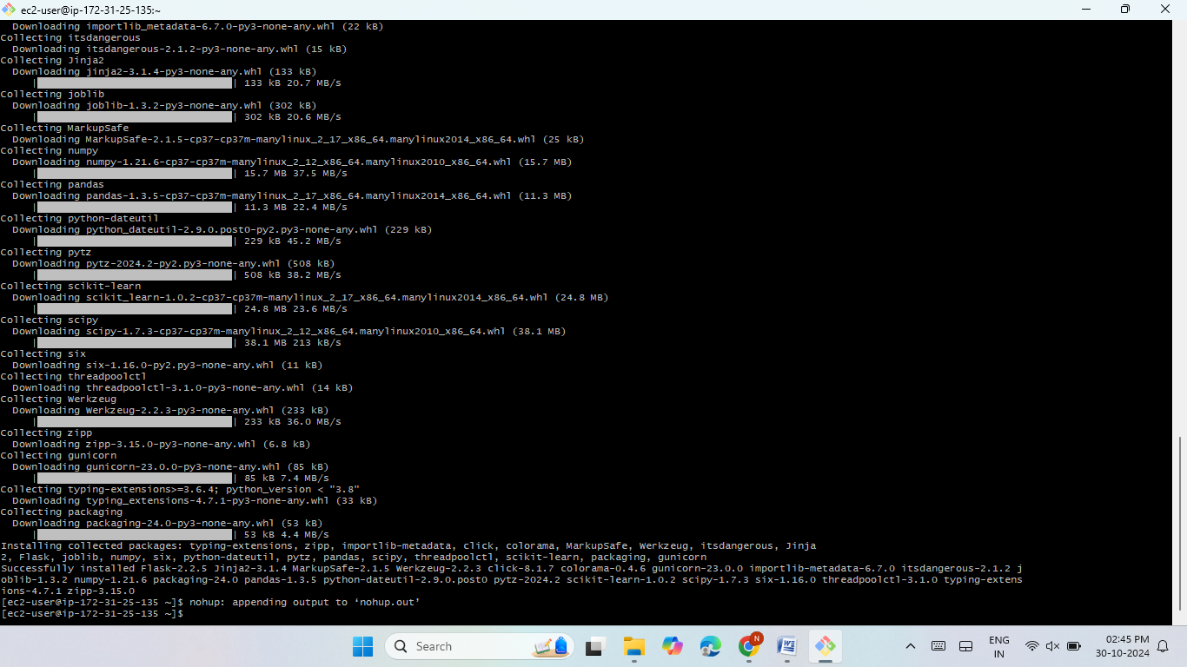


Slide 9
Method 4 - Using Git, Jenkins, and EC2
Overview:
CI/CD pipeline with Git and Jenkins on EC2.
Steps:
Set up Jenkins on EC2.
Create Jenkins jobs to pull code from Git.
Use shell scripts in Jenkins to deploy applications.
Benefit:
Automates deployments using a CI/CD approach.

Slide 10
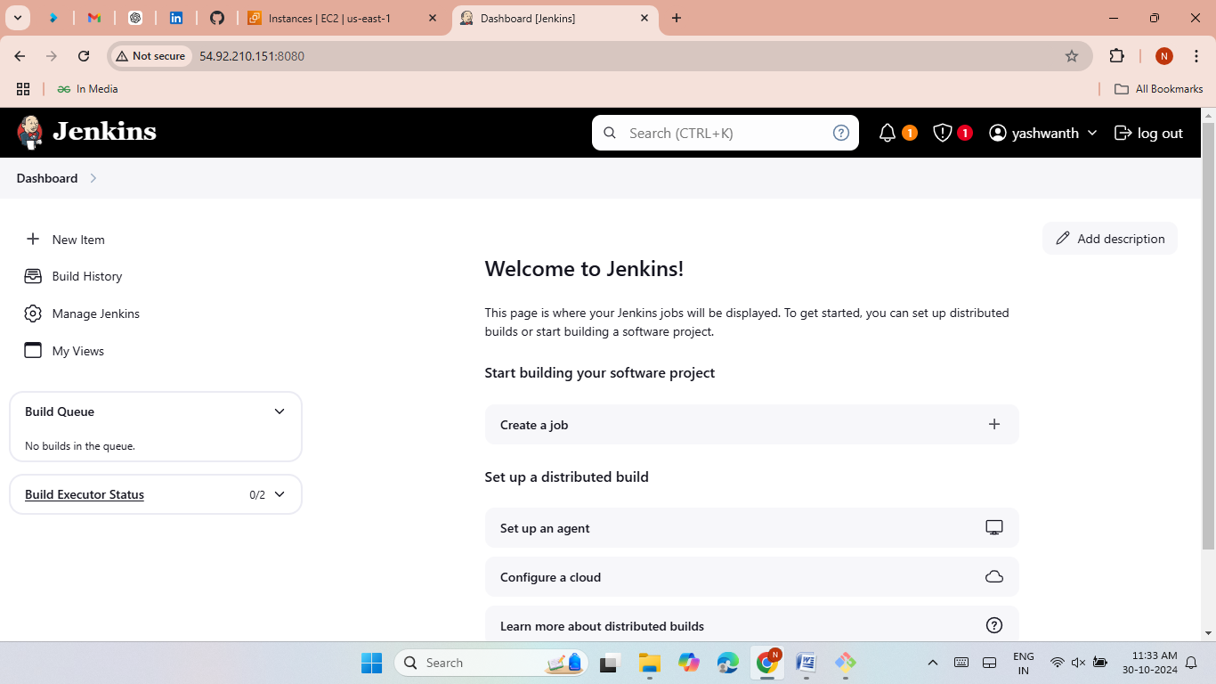
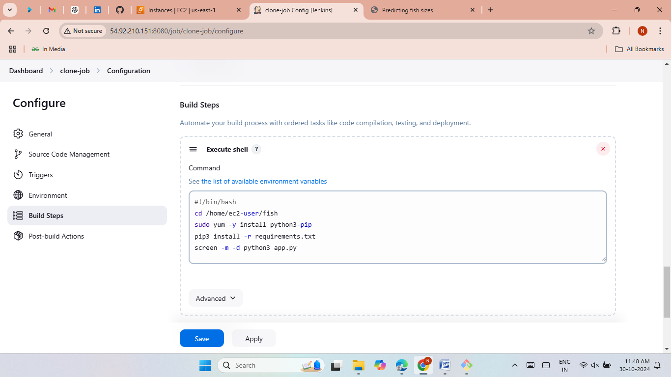
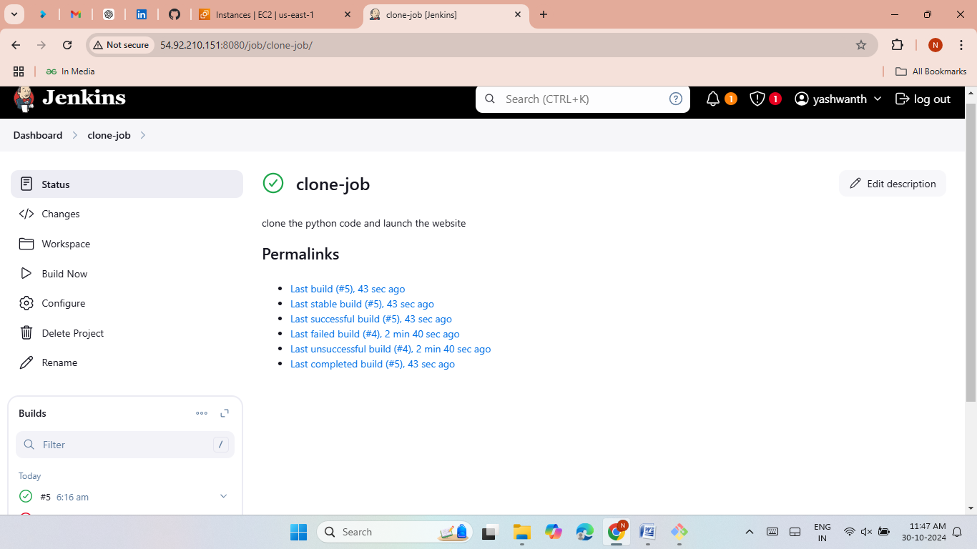
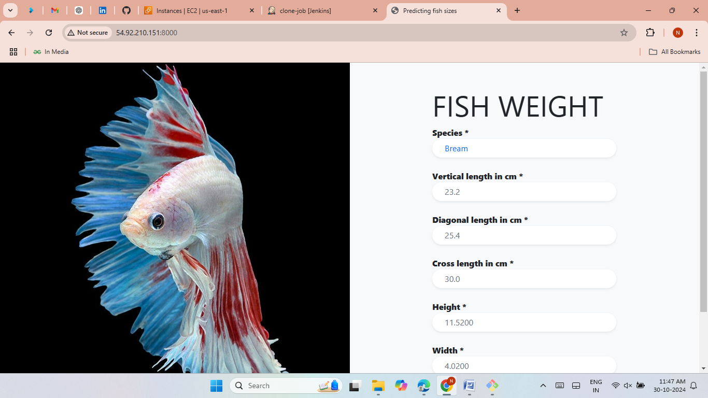

Slide 11
Method 5 - Terraform Deployment
Overview:
Use Terraform to manage infrastructure and deploy applications.
Steps:
Write Terraform scripts to launch EC2, VPC, Security Groups, and more.
Use a data script to deploy applications upon instance creation.
Benefit:
Infrastructure as Code (IaC) for consistent deployments.

Slide 12
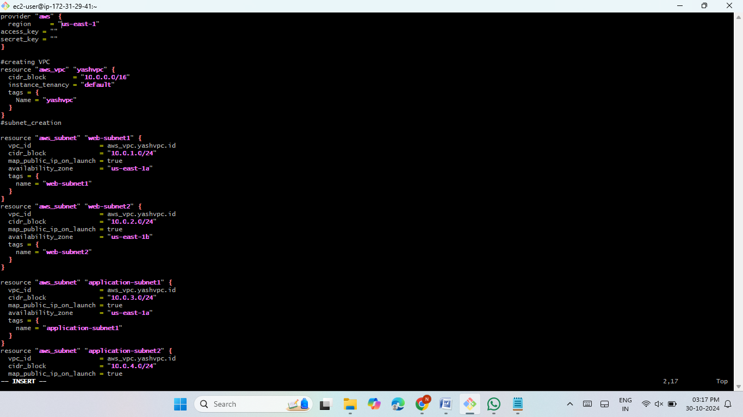
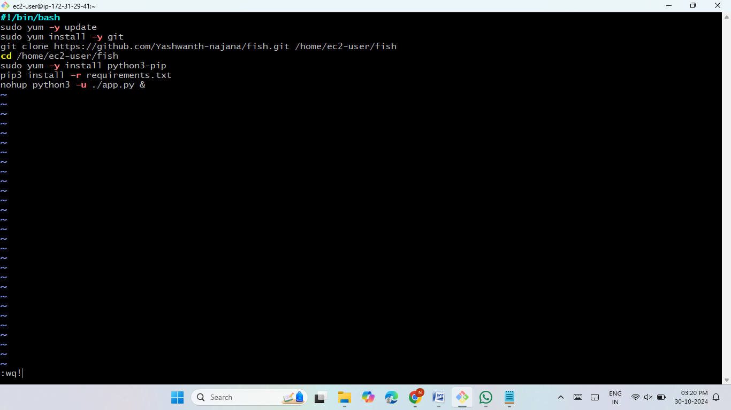
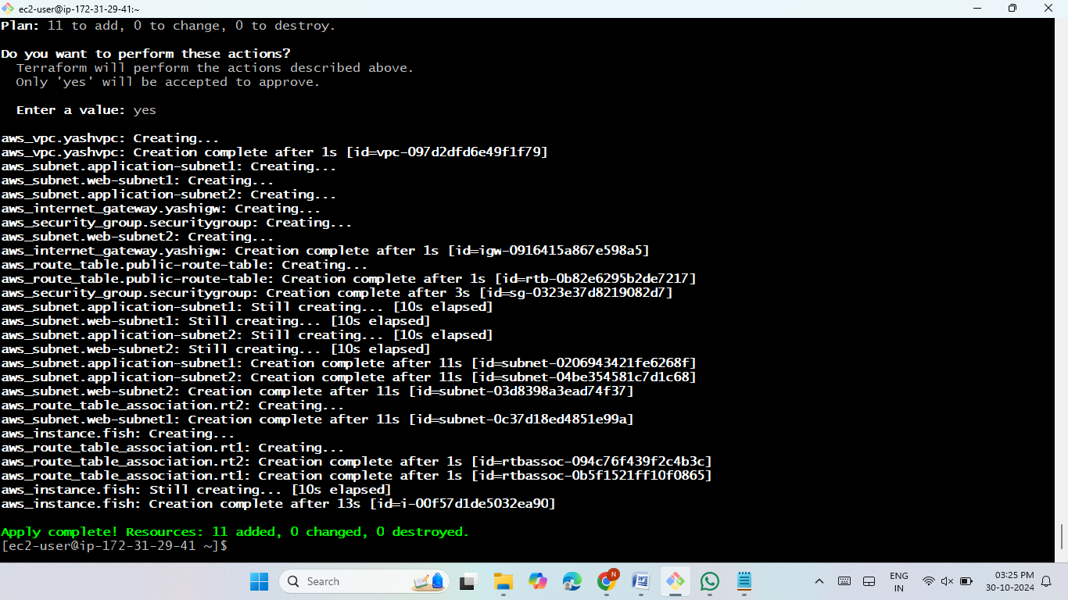
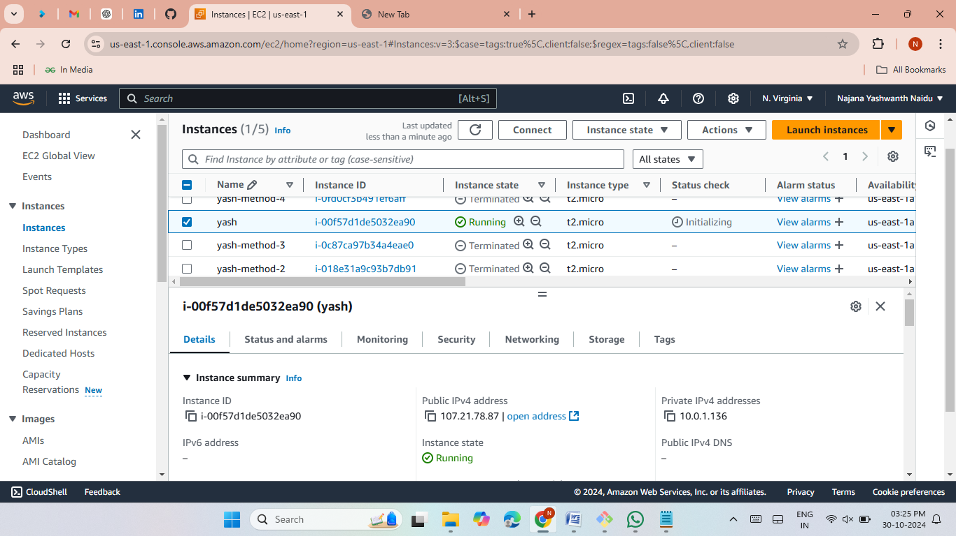


Slide 13
Method 6 - Git, Jenkins, and Terraform
Overview:
Advanced deployment using Git, Jenkins, and Terraform.
Steps:
Set up Jenkins to trigger Terraform scripts.
Use Terraform to manage AWS resources and deploy applications.
Benefit:
Full CI/CD with automated infrastructure setup.

Slide 14
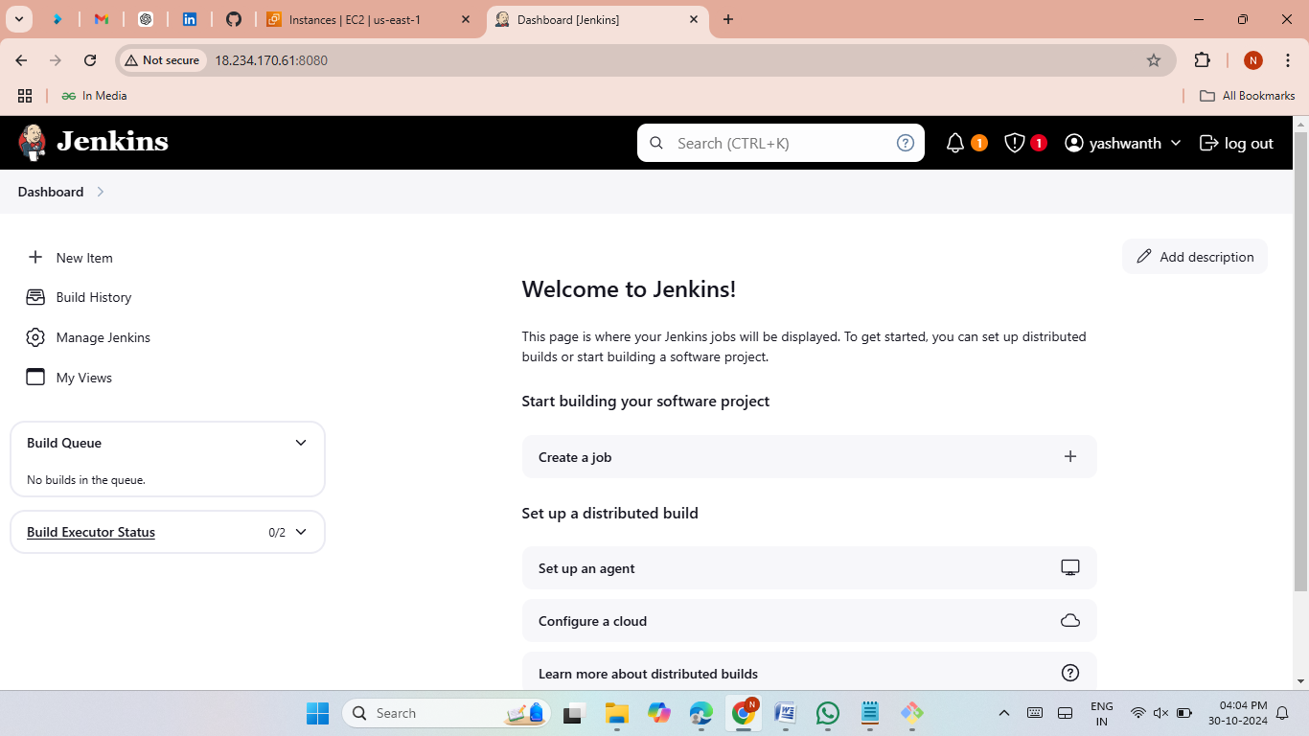
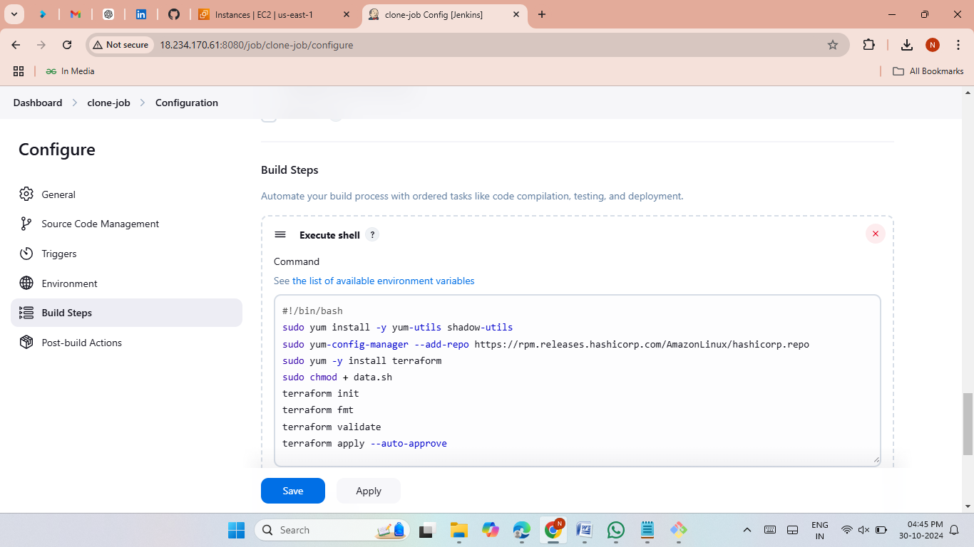
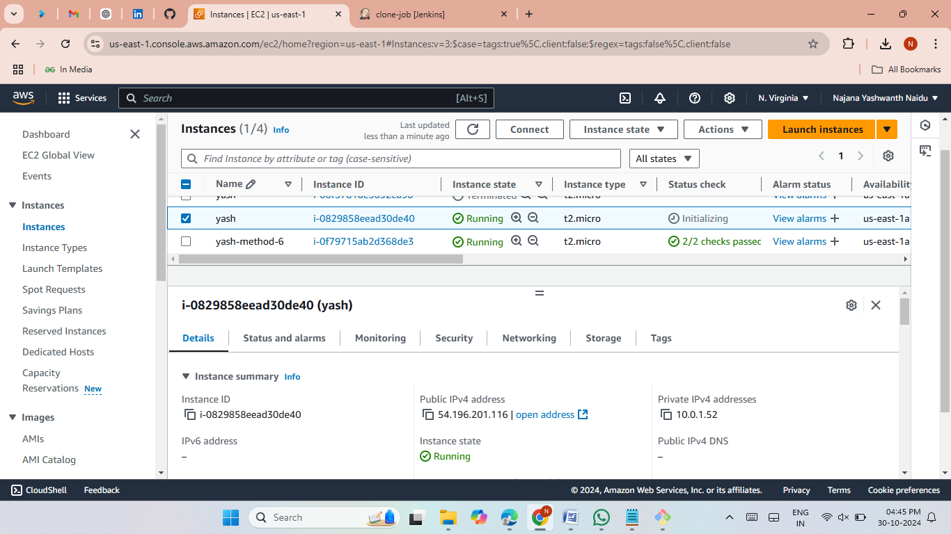


Slide 15
Method 7 - Docker Deployment
Overview:
Use Docker to containerize applications and deploy on EC2.
Steps:
Install Docker, build a Dockerfile, and create an image.
Run the application in a Docker container.
Push the Docker image to DockerHub.
Benefit:
Containerized deployments for easy portability.

Slide 16
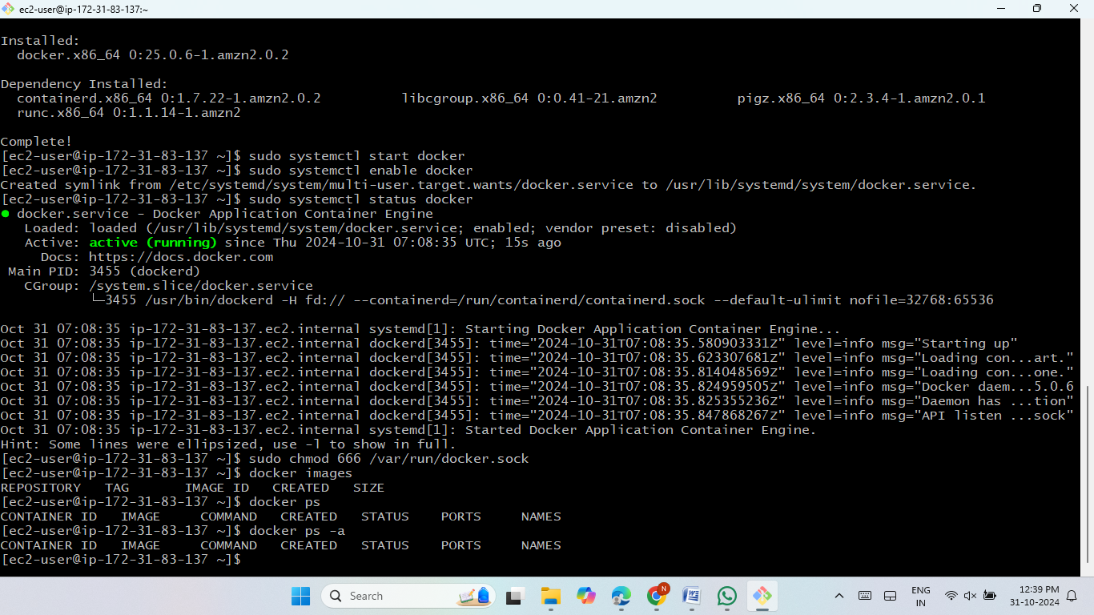
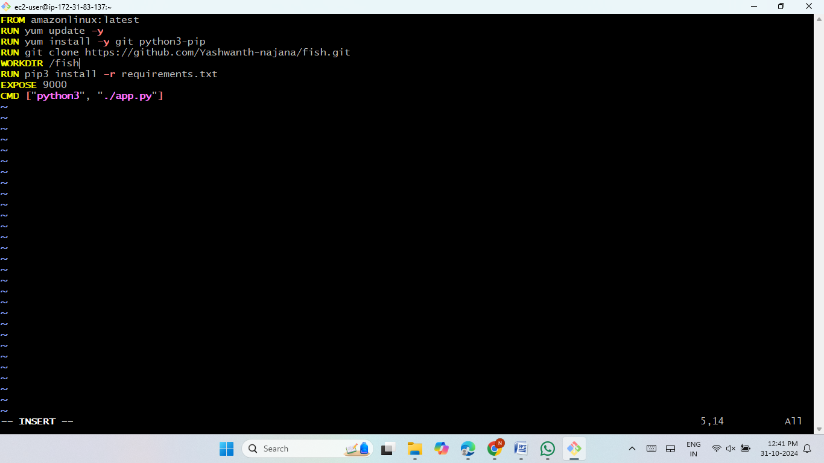
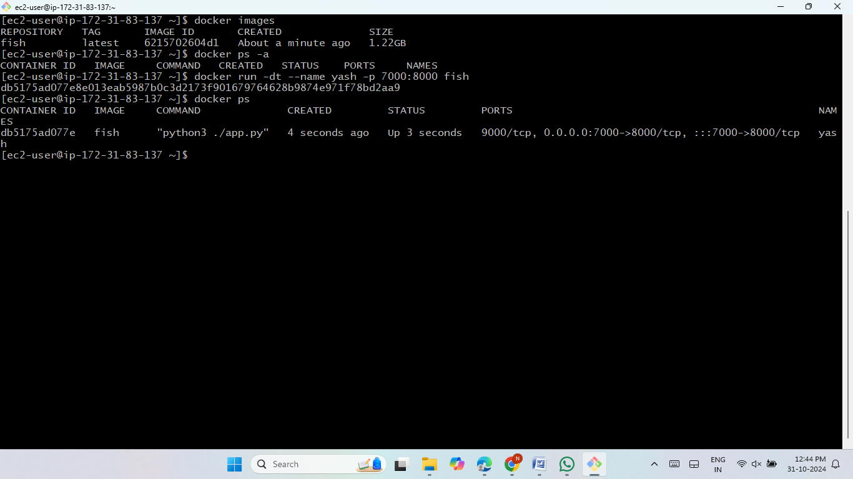


Slide 17
Method 8 - Kubernetes with Docker (EKS & KOPS)
Overview:
Deploy Docker containers in Kubernetes clusters.
Steps:
Set up EKS or KOPS cluster on AWS.
Use Kubernetes manifests (deployment.yaml and service.yaml) to deploy.
Access the app via Load Balancer.
Benefit:
Scalable, resilient deployments using Kubernetes.

Slide 18
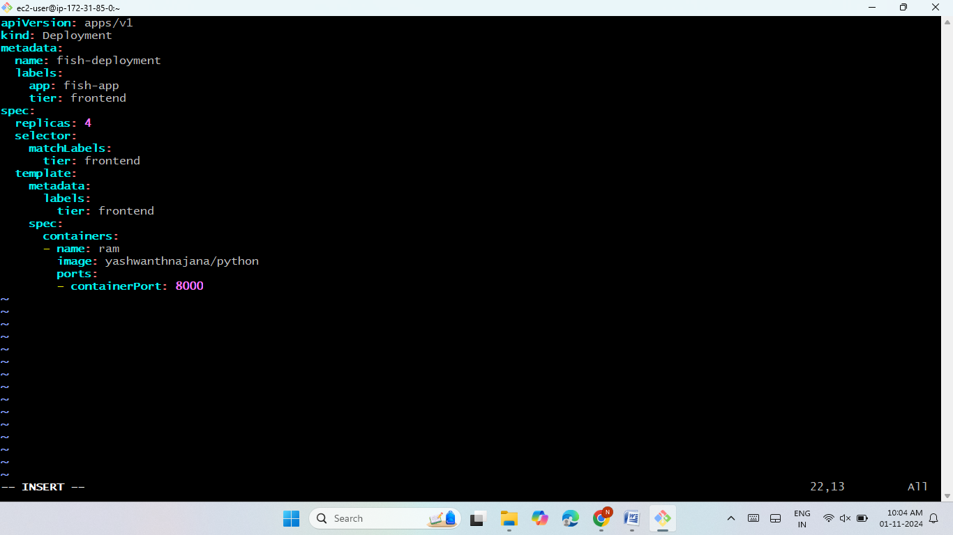
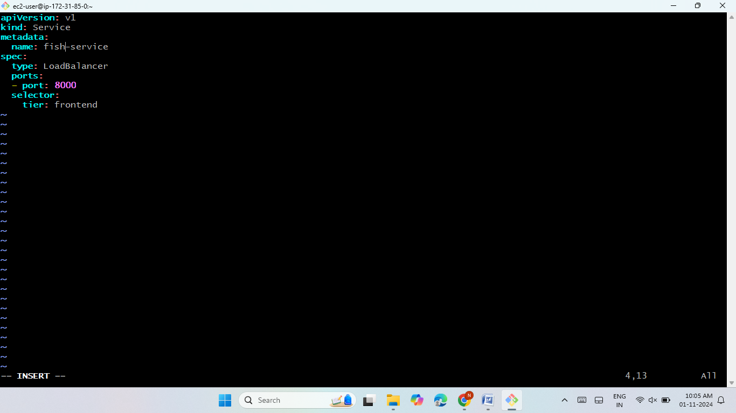
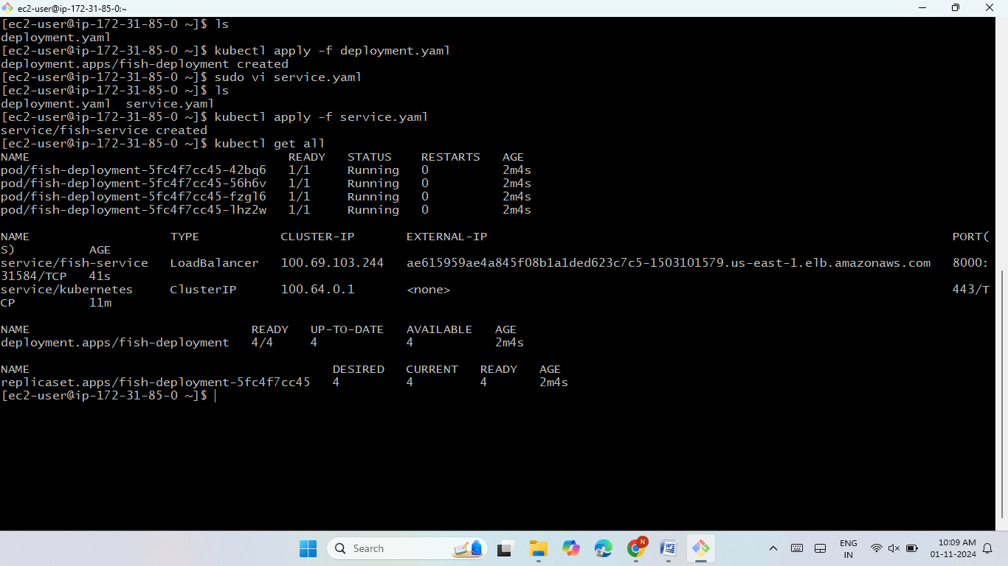

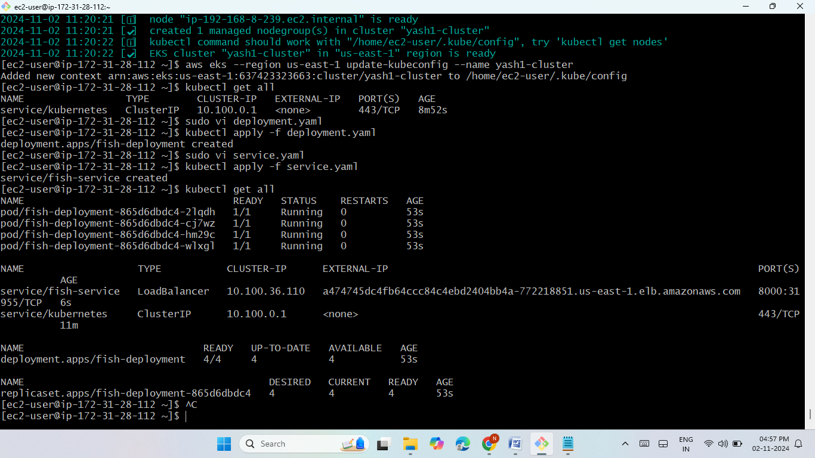


Slide 19
Method 9 - Jenkins and Terraform with Webhooks
Overview:
Integrate Jenkins with GitHub webhooks and Terraform.
Steps:
Add webhooks in GitHub.
Launch Jenkins then Clone terraform code then add Poll SCM, Build Periodically.
Trigger Terraform scripts for automatic deployments.
Benefit:
Automates deployments based on code changes.

Slide 20

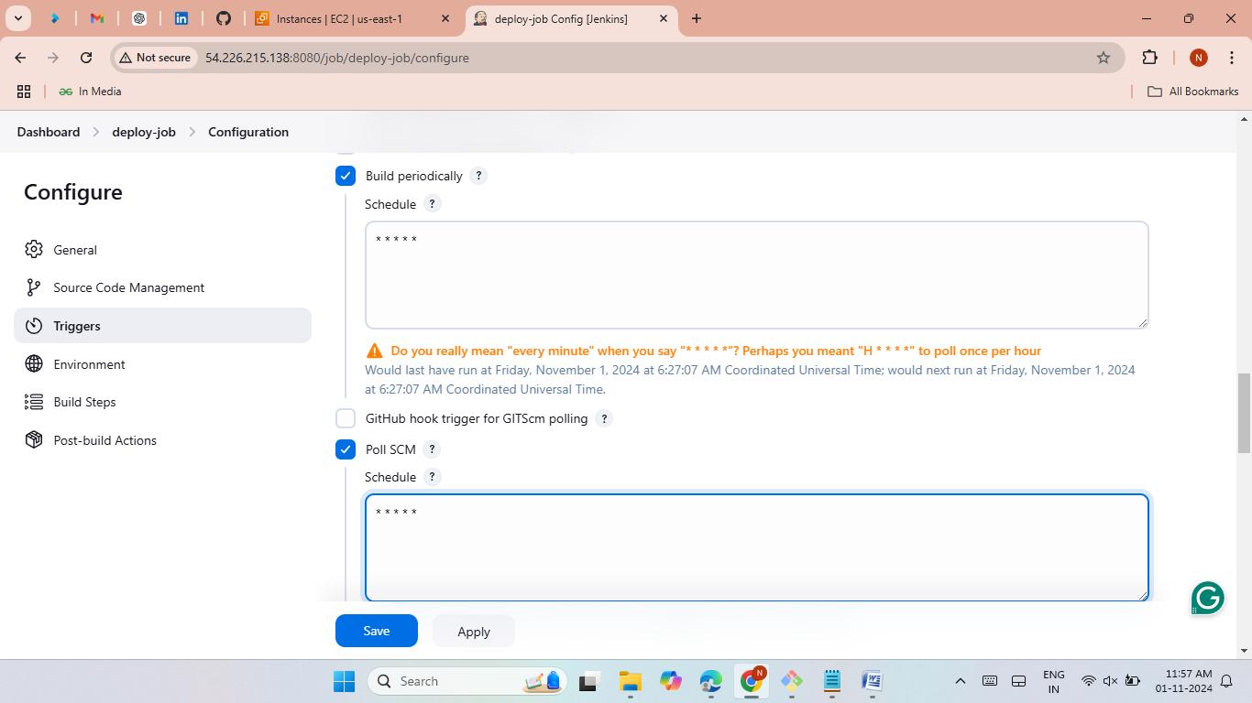
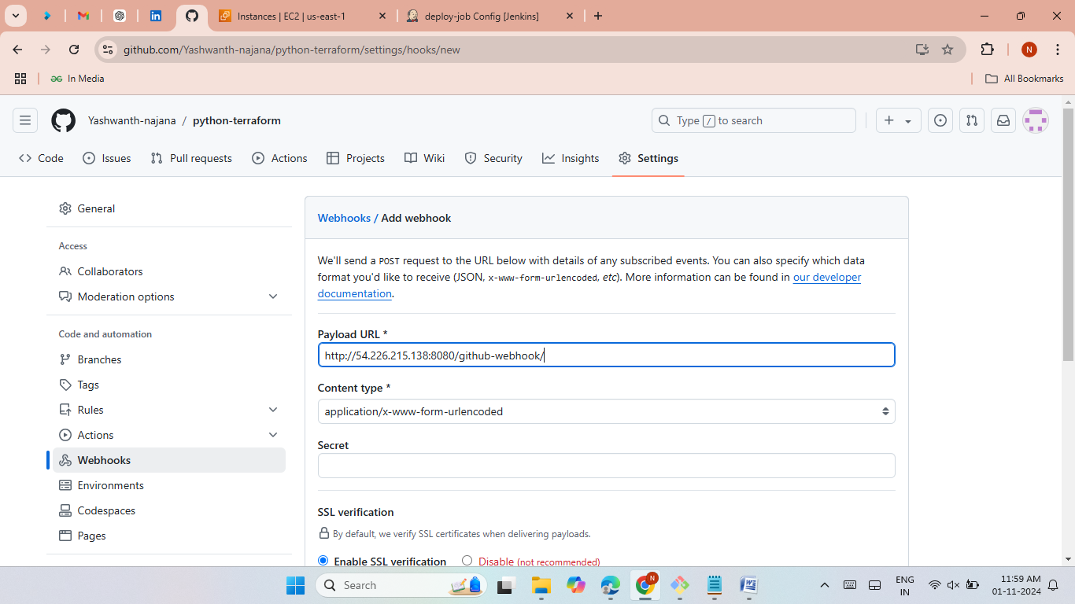
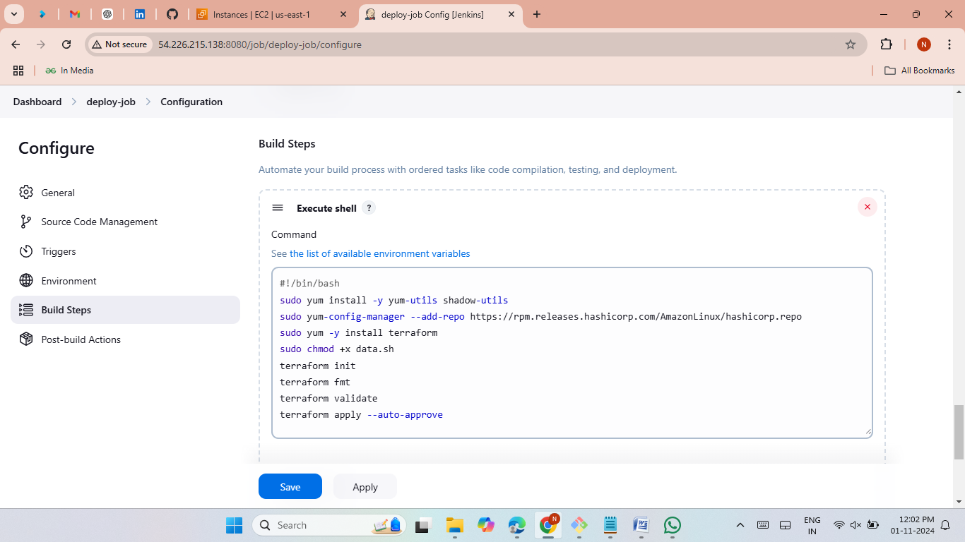
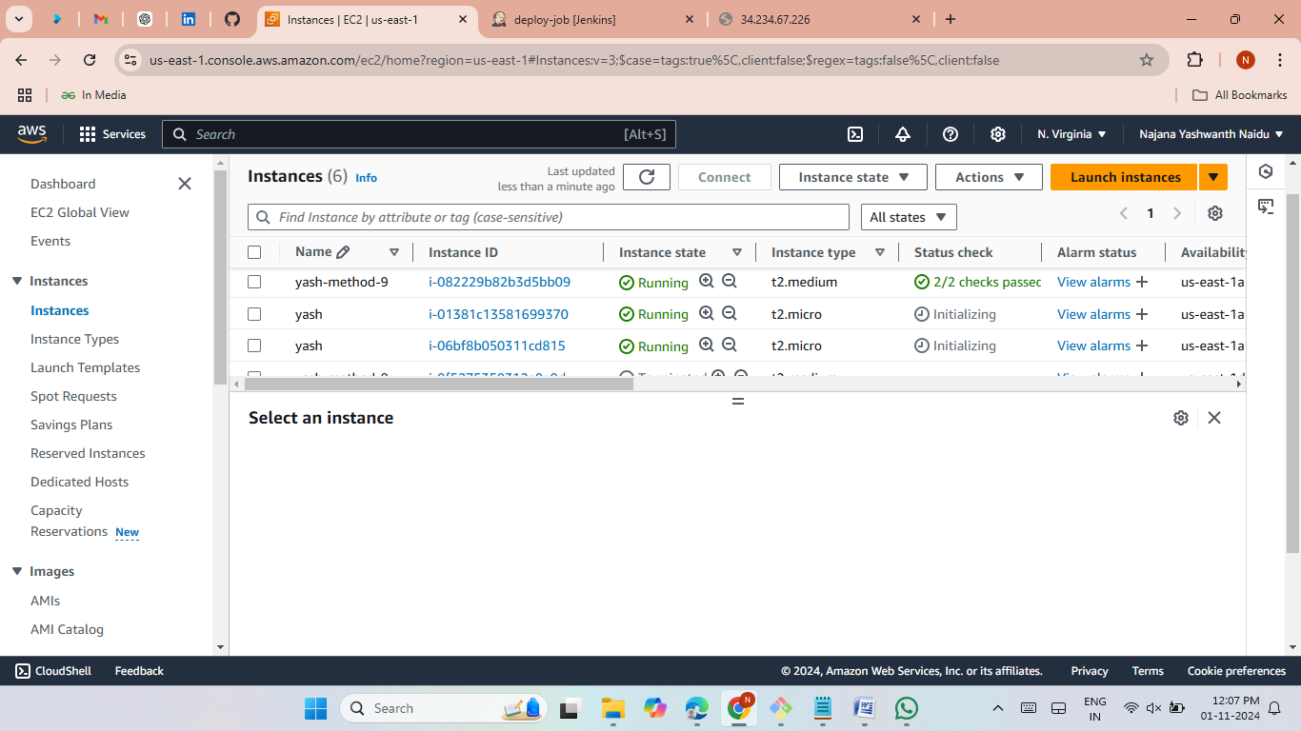


Slide 21
Method 10 - Jenkins Pipeline for CI/CD
Overview:
Create a Jenkins pipeline for full CI/CD with GitHub integration.
Steps:
Set up Jenkins clone and build jobs.
Use pipeline to automate deployments based on Poll SCM, Build Periodically and webhooks.
Benefit:
Efficient CI/CD workflow with continuous integration and deployment.

Slide 22

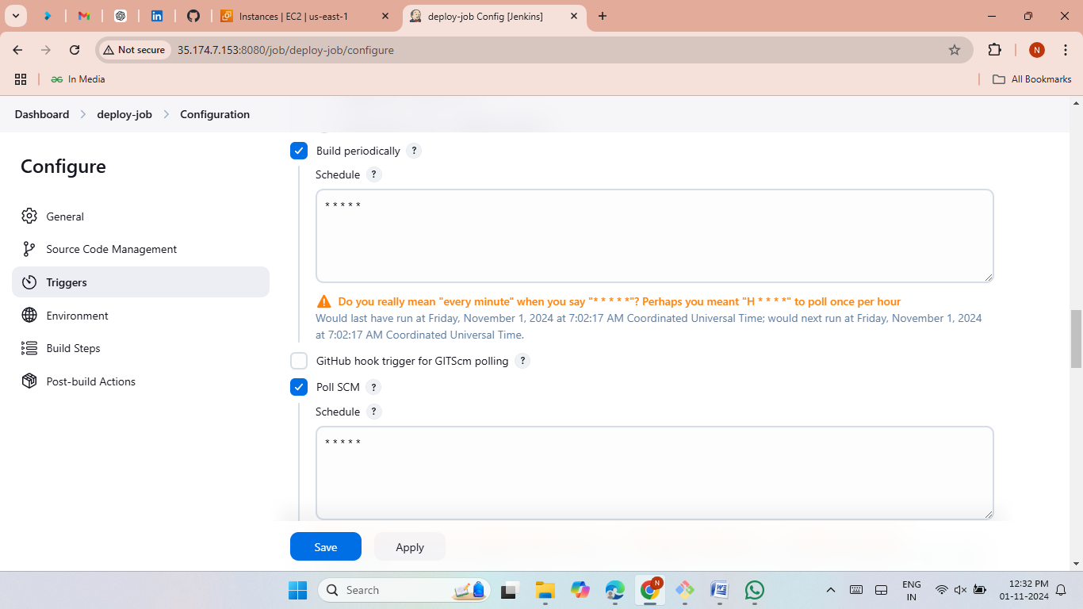
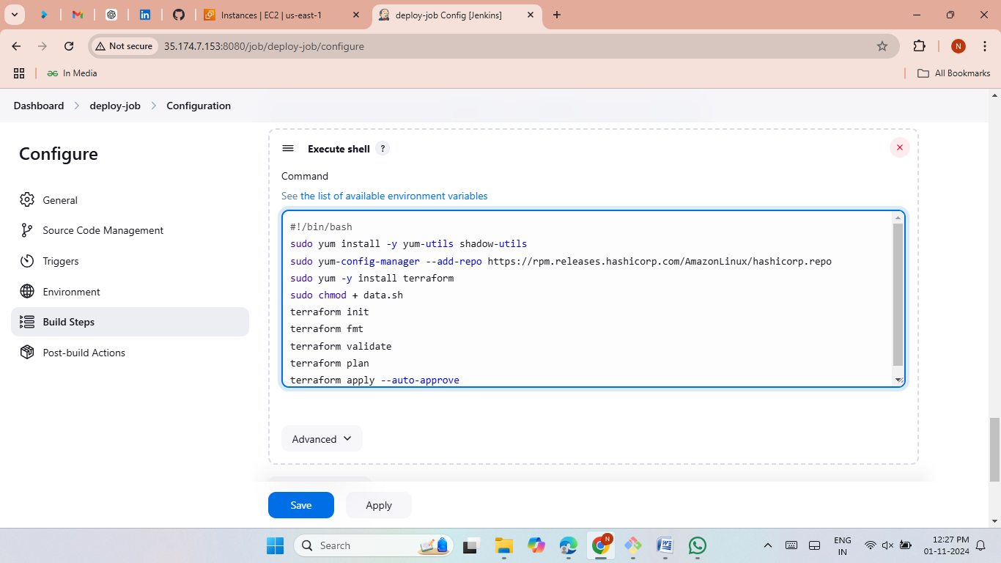

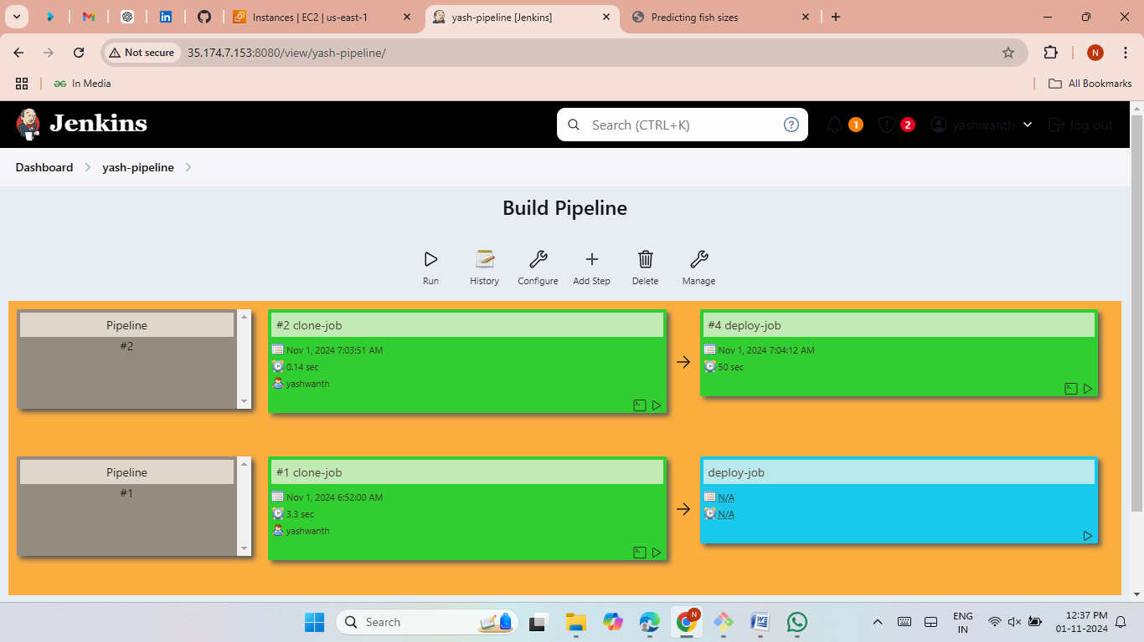

Slide 23
Thank you

